Slide 1



IP Addressing Fundamentals
Understanding IP Addresses
Public & Private IP

Slide 2









Public vs Private IP Addresses
Public IP Address
Private IP Address
A globally unique IP address that identifies a device on the internet. Assigned by an ISP, allowing direct communication with the wider internet.
An IP address used within a private network that is not visible or routable on the public internet. Enables secure communication between devices in the same local network.
Key Differences
Feature
Public IP Address
Private IP Address
Scope
Global
Local
Routability
Routable on the global internet
Not routable on the global internet
Uniqueness
Globally unique
Unique only within its local network
Cost
Assigned by ISP, often with a cost
Free to use within private networks
Visibility
Visible to the outside world
Not visible externally
Primary Use
Connect to the internet, external accessibility
Communication within a local network

Slide 3


Slide 4




Question 1
What is the address size for IPv4 and IPv6, respectively?
A
32-bit and 64-bit
B
64-bit and 128-bit
C
32-bit and 128-bit
D
128-bit and 256-bit

Slide 5














Correct Answer: C. 32-bit and 128-bit
Explanation:
IPv4 addresses are 32 bits long, while IPv6 addresses are 128 bits long. This significant difference in address size provides IPv6 with a vastly larger address space.
IPv4
32 bits
IPv6
128 bits
Did You Know?
The larger address space of IPv6 (2^128 possible addresses) is approximately 340 undecillion addresses, which is vastly more than IPv4's 2^32 addresses (4.3 billion).

Slide 6








Question 2
Which security feature is built into IPv6 as a standard, unlike IPv4 where it is optional?
A
Firewall
B
Network Address Translation (NAT)
Network security mechanism
Address conversion mechanism
C
Internet Protocol Security (IPsec)
D
Virtual Private Network (VPN)
Authentication and encryption
Secure connection method

Slide 7







Correct Answer: C. Internet Protocol Security (IPsec)
Explanation:
IPv6 has built-in Internet Protocol Security (IPsec) as a standard feature, offering authentication and encryption. While IPv4 can use IPsec, it is not mandatory and lacks native security features.
IPv6 Security Model
IPv4 Security Model
IPsec is mandatory for IPv6 implementations
IPsec is optional and not universally implemented
Provides authentication of data origin
Lacks mandatory authentication in standard implementation
Offers encryption for data confidentiality
Security features added as extensions rather than core functionality
Key Takeaway: IPv6's integrated IPsec provides end-to-end security as a core feature, enhancing network security from the ground up.

Slide 8






Question 3
Which notation is typically used for IPv6 addresses?
A
Decimal dotted notation
B
Hexadecimal colon-separated notation
Similar to IPv4
Uses hex values separated by colons
C
Binary dotted notation
D
Octal colon-separated notation
Base-2 representation
Base-8 representation

Slide 9






Answer 3
Correct Answer: B. Hexadecimal colon-separated notation
Explanation:
IPv6 addresses are represented using hexadecimal colon-separated notation, whereas IPv4 uses decimal dotted notation.
IPv6 Notation
IPv4 Notation
Hexadecimal colon-separated notation uses groups of four hexadecimal characters separated by colons.
Decimal dotted notation uses groups of decimal numbers separated by dots.
2001:0db8:85a3:0000:0000:8a2e:0370:7334
192.168.1.1
Each group represents 16 bits (4 hex characters)
Each group represents 8 bits (0-255)
Did You Know?
IPv6 was designed to address the limitations of IPv4, including the exhaustion of available addresses. The larger address space of IPv6 (128 bits vs 32 bits) provides a vastly increased number of unique addresses.

Slide 10


Slide 11















IPv4 vs IPv6
IPv4
IPv6
Internet Protocol version 4 uses 32-bit addresses, which limits the total number of available addresses to approximately 4.3 billion.
Internet Protocol version 6 uses 128-bit addresses, providing a vastly larger address space to accommodate the growing internet needs.
192.168.1.1
2001:0db8:85a3:0000:0000:8a2e:0370:7334
Key Differences
Address Length
Notation
32-bit vs 128-bit
Dot-decimal vs Hexadecimal with colons
Address Space
Compression
4.3 billion vs 3.4×10³⁸
Leading zeros can be omitted

Slide 13







Question 1
Which of the following IP address ranges is reserved for private networks according to RFC 1918?
A
8.8.8.0/24
B
172.16.0.0/12
Public IP range (Google DNS)
Valid private IP range
C
203.0.113.0/24
D
1.1.1.0/24
Documentation range
Public IP range

Slide 14











Correct Answer: B. 172.16.0.0/12
Explanation:
The Internet Assigned Numbers Authority (IANA) reserves specific IPv4 address ranges for private internets, as defined in RFC 1918. These ranges include:
10.0.0.0/8
172.16.0.0/12
192.168.0.0/16
Class A private network range
Class B private network range
Class C private network range
These private IP ranges can be used freely within private networks without requiring registration with IANA. They are not accessible from the public internet without Network Address Translation (NAT).
Key Points:
Private IP addresses are not routable on the public internet
NAT is used to translate private addresses to public addresses for internet communication
RFC 1918 defines the standards for private IP addressing

Slide 16


















What is CIDR (Classless Inter-Domain Routing)?
Definition
CIDR Notation
A fundamental method introduced in 1993 to enhance efficiency of IP address allocation and optimize internet routing.
Provides a concise way to represent an IP address and its associated network mask.
Format: IP address/prefix length
Purpose
192.168.1.0/24
(Example)
Maximize utilization of finite IPv4 address space
Mitigate rapid growth of routing tables
The prefix length specifies the number of bits dedicated to the network portion.
Enable flexible IP address assignment without class boundaries
Visual Representation
Previous System
In /24 notation:
Replaced the traditional classful network addressing system which rigidly categorized IP addresses into classes A, B, and C.
1
1
1
1
1
1
1
1
0
0
0
0
0
0
0
0
Network (24 bits)
Host (8 bits)
The /24 indicates that the first 24 bits are used for the network portion, while the remaining 8 bits are available for host addresses.

Slide 17













CIDR Prefix Table
CIDR notation provides a concise way to represent IP addresses and their associated network mask. The table below shows the relationship between CIDR prefixes and available IP addresses.
CIDR Prefix
Subnet Mask
Total IP Addresses
Usable IP Addresses
/8
255.0.0.0
16,777,216
16,777,214
/9
255.128.0.0
8,388,608
8,388,606
/10
255.192.0.0
4,194,304
4,194,302
/11
255.224.0.0
2,097,152
2,097,150
/12
255.240.0.0
1,048,576
1,048,574
/13
255.248.0.0
524,288
524,286
/14
255.252.0.0
262,144
262,142
/15
255.254.0.0
131,072
131,070
/16
255.255.0.0
65,536
65,534
/17
255.255.128.0
32,768
32,766
/18
255.255.192.0
16,384
16,382
/19
255.255.224.0
8,192
8,190
/20
255.255.240.0
4,096
4,094
/21
255.255.248.0
2,048
2,046
/22
255.255.252.0
1,024
1,022
/23
255.255.254.0
512
510
/24
255.255.255.0
256
254
/25
255.255.255.128
128
126
/26
255.255.255.192
64
62
/27
255.255.255.224
32
30
/28
255.255.255.240
16
14
/29
255.255.255.248
8
6
/30
255.255.255.252
4
2

Slide 19











Question 1
Which part of the CIDR notation 192.168.1.0/24 indicates the number of bits used for the network portion of the IP address?
CIDR Notation Breakdown:
192
168
1
0
/24
1
1
1
1
1
1
1
1
1
1
1
1
1
1
1
1
1
1
1
1
1
1
1
1
0
0
0
0
0
0
0
0
Network Bits
Host Bits
A
`192.168.1.0`
B
`24`
Identifies the host address
Prefix length in bits
C
`192`
D
`0`
First octet
Last digit

Slide 20




Correct Answer:
B. `24`
Which part of the CIDR notation 192.168.1.0/24 indicates the number of bits used for the network portion of the IP address?
Explanation:
In CIDR notation, the number following the slash (e.g., /24) represents the prefix length, which specifies the number of bits used for the network portion of the IP address. The remaining bits are used for host addresses.
CIDR Notation Breakdown
Network Bits
/
Prefix Length
192.168.1
24
Key Point: The prefix length is a compact way to represent the subnet mask. A /24 prefix corresponds to a 255.255.255.0 subnet mask, indicating that the first 24 bits are used for the network portion.

Slide 21






Question 2
How many usable host IP addresses are available in a subnet with a CIDR block of 10.0.0.0/28?
Understanding /28 CIDR Notation
10
.
0
.
0
.
0
0
0
0
0
Network Bits (28)
Host Bits (4)
A
2
B
6
Incorrect calculation
Close, but not final answer
C
14
D
30
Correct answer
Incorrect calculation

Slide 22









Answer 2
Correct Answer:
C. 14
Calculation Explanation:
1
Given: /28 CIDR block means 28 bits are used for the network portion
2
Host bits: 32 - 28 = 4 bits available for host addresses
3
Total addresses: 2 = 16
4
Usable hosts: 16 - 2 = 14 (subtracting network and broadcast addresses)
Subnet Breakdown:
Network bits (28)
Network Address
14 Usable IPs
Broadcast Address
Host bits (4)

Slide 23









Question 3
Given the subnet 172.16.10.0/27, which of the following is a valid host IP address within this subnet?
Subnet Analysis: 172.16.10.0/27
172
16
10
0
Network Address
0
32
64
96
128
160
192
224
255
Network bits (27)
Host bits (5)
Valid host range: 172.16.10.1 - 172.16.10.30 Broadcast address: 172.16.10.31
A
172.16.10.0
B
172.16.10.31
Network address - not a valid host
Broadcast address - not a valid host
C
172.16.10.15
D
172.16.10.32
Valid host address
Out of range for this subnet

Slide 24







Correct Answer: C. 172.16.10.15
Given the subnet 172.16.10.0/27, which of the following is a valid host IP address within this subnet?
Explanation:
A /27 CIDR block means 27 bits are used for the network portion, leaving 5 bits for host addresses.
Network Bits
Host Bits
Total Addresses
27
5
Bits
Bits
2 = 32
Per Subnet
Network Information:
Network address: 172.16.10.0
Broadcast address: 172.16.10.31
Usable host addresses: 172.16.10.1 to 172.16.10.30
172.16.10.0/27
Key Point: The IP address 172.16.10.15 falls within the valid range of usable host addresses (172.16.10.1 to 172.16.10.30), making it a valid host IP address in this subnet.

Slide 25









Understanding Virtual Private Cloud (VPC)
A Comprehensive Overview
VPC Concept & Overview
Subnets & IP Addressing
Internet Gateway & Route Table

Slide 26
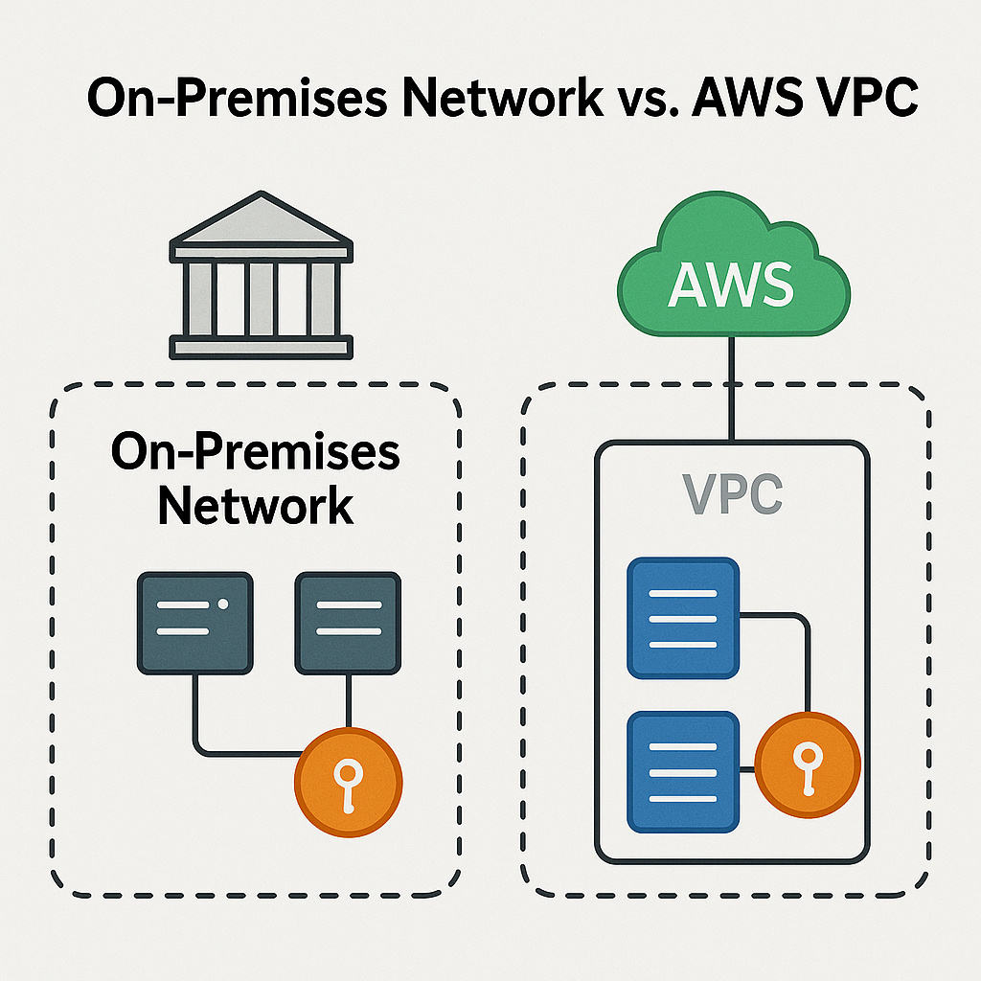
What do you get with a VPC?
Private isolated network space
Custom setup
Internet access control
Notes:
Private space: Only you control who gets in and out.
Custom setup: You decide how many servers, where they go (subnets), and who can talk to whom (firewalls/security groups).
Internet access control: You choose which parts of your roomc an connect to the internet and which should stay isolated.

Slide 27



















VPC Fundamentals
Core Architecture
Key Components
User-Defined IP Range: VPCs are characterized by a user-specified IP address range
Subnets
Logical Isolation: Partitions shared public cloud infrastructure into securely isolated sections
Route Tables
Customizable Network Space: Users can define subnets, configure routing rules, and apply security policies
Internet Gateway
Traditional Network Mirror: Resembles on-premises networks while offering cloud scalability and flexibility
Security Groups
NAT Gateway
These components work together to provide a comprehensive and secure networking environment for cloud resources.

Slide 28












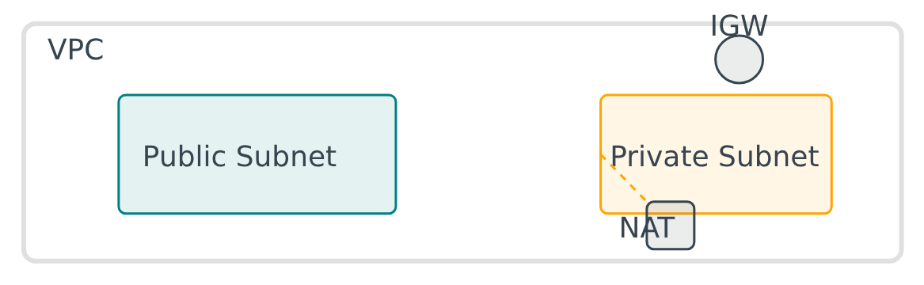
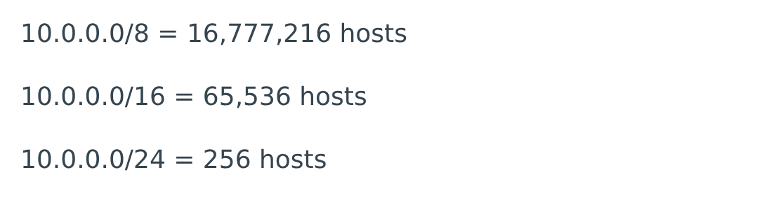


Subnets & IP Addressing
Understanding Subnets
IP Addressing Explained
Design Best Practices
Logical Subdivision: Range of IP addresses within a VPC
CIDR Notation: Defines IP blocks (e.g., 10.0.0.0/16)
Subnet Sizing: Balance IP address availability with efficient utilization
Subnet Type
Access Type
Routing Target
Private IPs: RFC 1918 ranges (10.0.0.0/8, 172.16.0.0/12, 192.168.0.0/16)
Non-overlapping CIDRs: Ensure CIDR blocks don't overlap to prevent routing conflicts
Public
Direct internet access
Internet Gateway
Public IPs: Assigned public IPs or Elastic IPs
IPv6: Unique Local Addresses (ULAs) and Global Unicast Addresses
Security Segmentation: Use separate subnets to isolate workloads
Private
Outbound via NAT
NAT Gateway
Multi-tier Architecture: Design subnets to support multi-tier applications
CIDR Calculator:
Plan for future growth when designing subnets and ensure adequate IP address space for your applications.

Slide 29


















Internet Gateway & Route Table
Internet Gateway (IGW)
Route Table
Two-Way Communication: Enables resources in your VPC to communicate with the public internet
Traffic Direction: Set of rules that dictates how network traffic is directed both within and outside the VPC
High Availability: Horizontally scaled component designed for reliability and uptime
Route Structure: Each rule specifies a destination IP range (CIDR block) and a target (next hop)
1:1 NAT Services: Maps public IP addresses to private instances
Target Options: Next hop can be an Internet Gateway, NAT Gateway, VPC Peering connection, or other network devices
Attachment Required: Must be created and attached to the VPC to enable internet connectivity
Association: Each subnet must be associated with exactly one route table
Route Table
IGW

Slide 31




Question 1
What is the main purpose of an Internet Gateway (IGW) in an AWS VPC?
A
To provide private connectivity between VPCs in different regions.
B
To allow instances in private subnets to access the internet.
For cross-region VPC communication
Enables internet access for private resources
C
To enable communication between instances in a VPC and the internet.
D
To route traffic between subnets within the same VPC.
Main purpose - connecting VPC to internet
For internal VPC traffic routing

Slide 32







CORRECT ANSWER
C. To enable communication between instances in a VPC and the internet.
Explanation:
An Internet Gateway is a horizontally scaled, redundant, and highly available VPC component that allows communication between instances in a VPC and the internet.
Serves as a target in VPC route tables for internet-routable traffic
Enables instances in private subnets to access the internet
Provides a single point of connectivity between the VPC and external networks

Slide 33




Question 2
Which statement accurately defines a public subnet in an AWS VPC?
A
A subnet that has a route to a NAT Gateway
B
A subnet that has a route to an Internet Gateway
Incorrect - NAT Gateway enables outbound connectivity
Correct - Direct connectivity to internet
C
A subnet whose instances are only accessible via a VPN connection
D
A subnet that contains only private IP addresses
Incorrect - Definition of private subnet
Incorrect - Private subnet definition
Public Subnet Characteristics
Route to Internet Gateway
Public IP addressing
Direct internet connectivity

Slide 34







Answer 2
Which statement accurately defines a public subnet in an AWS VPC?
B
A subnet that has a route to an Internet Gateway.
Explanation:
A public subnet is a subnet whose route table contains a route to an Internet Gateway, allowing resources within it to communicate directly with the internet.
Key components: Route table with Internet Gateway route, proper NACLs, and subnet CIDR
Resources in public subnets can be accessed from the internet using public IP addresses
Public subnets are typically used for resources that need to be publicly accessible
VPC
Route
Internet Gateway
Public Subnet
10.0.0.0/16
10.0.1.0/24

Slide 35



Question 3
What is the primary role of a Route Table in an AWS VPC?
A
To filter network traffic based on IP addresses and ports
B
To define the IP address range for a VPC
Similar to Security Groups but for traffic filtering
This is done through VPC CIDR blocks
C
To determine where network traffic from a subnet is directed
D
To provide private connectivity to AWS services
Uses routes to direct traffic to appropriate destinations
This is the role of VPC Endpoints

Slide 36











Correct Answer: C. To determine where network traffic from a subnet is directed.
Explanation:
Route tables contain a set of rules, called routes, that are used to determine where network traffic from a subnet or gateway is directed. Each route specifies a destination CIDR block and a target (such as an Internet Gateway, NAT Gateway, or peering connection).
Route Table
Subnet
Destination
Contains routing rules
Network traffic
Internet/other networks
Key Points about Route Tables:
Each VPC has a main route table that's associated with all subnets unless specified otherwise
Custom route tables can be created and associated with specific subnets
Routes can direct traffic to an Internet Gateway, NAT Gateway, peering connection, or local VPC
Route tables are essential for controlling network traffic flow in a VPC

Slide 37


Question 4
Which statement accurately defines a characteristic of AWS Security Groups?
A
They are applied at the subnet level.
B
They are stateless.
Incorrect - Security Groups are applied at the instance level
Incorrect - Security Groups are stateful
C
They explicitly deny all traffic by default.
D
They are stateful.
Incorrect - Security Groups allow all traffic by default
Correct - If you allow inbound traffic, corresponding outbound traffic is automatically allowed

Slide 38








Answer 4
Correct Answer:
D. They are stateful.
Explanation:
Security Groups are stateful, meaning they maintain connection state information. If you allow an inbound request, the corresponding outbound traffic is automatically allowed, and vice versa.
Key Characteristics
Difference from NACLs
Stateful: Tracks connection state
NACLs are stateless
Applied at instance level
NACLs require rules for both directions
Not explicitly deny all traffic
The Security Group automatically allows the outbound response
Inbound
Security Group
✓
Outbound
Instance

Slide 39




Question 5
What is the primary use case for an AWS NAT Gateway?
A
To allow inbound internet traffic to instances in a private subnet.
B
To enable instances in a private subnet to initiate outbound connections to the internet.
Incorrect - NAT Gateway doesn't allow inbound traffic
Correct - This is the primary use case
NAT Gateway
C
To establish private connectivity between two VPCs.
D
To provide a public IP address to instances in a private subnet.
Incorrect - Use VPC Peering for this
Incorrect - NAT Gateway uses Elastic IP

Slide 40


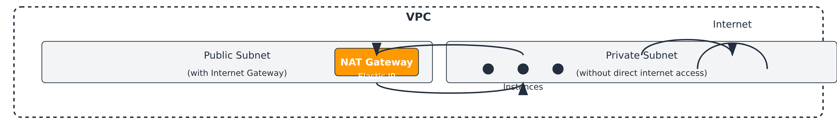

Answer 17: NAT Gateway Use Case
CORRECT
B. To enable instances in a private subnet to initiate outbound connections to the internet.
Explanation:
A NAT Gateway allows instances in private subnets to connect to services outside the VPC (like the internet or other AWS services) while preventing external services from initiating connections with those instances.
It enables outbound connectivity while blocking inbound connections from the internet
It uses an Elastic IP address to provide this functionality
It's specifically designed for this use case and is more reliable than NAT instances
NAT Gateway is a managed service that provides higher bandwidth and automatic scaling compared to NAT instances.
35 / 61

Slide 42




VPC Peering Connection
Secure and efficient inter-VPC communication in the AWS cloud
VPC A
VPC B

Slide 43










Introduction to VPC Peering
VPC Peering is a networking connection between two Virtual Private Clouds that allows them to communicate with each other using private IP addresses as if they were part of the same network.
VPC A
VPC Peering Connection
VPC B
Private IP Range: 10.0.0.0/16
Private IP Range: 10.1.0.0/16
Secure Communication
Seamless Integration
Operational Simplicity
Traffic remains within the cloud provider's private network, keeping it off the public internet.
Enables resources in different VPCs to communicate as if they were on the same network.
Eliminates the need for complex VPNs, NAT gateways, or physical hardware for inter-VPC communication.

Slide 44












Core Benefits
Key advantages of VPC Peering for secure and efficient inter-VPC communication
Low Latency & High Throughput
Reduced Costs
Traffic flows efficiently by leveraging the cloud provider's backbone network, ensuring fast and reliable communication between VPCs.
Avoiding data transfer over public networks can significantly lower operational expenses compared to internet-based connectivity solutions.
Improved Security
High Availability
Keeps traffic encrypted and private within the provider network, reducing exposure to public internet threats like DDoS attacks.
Eliminates single points of failure often associated with complex routing solutions, ensuring continuous connectivity between VPCs.
VPC Peering provides a secure, efficient, and cost-effective way to connect multiple VPCs while maintaining network isolation and security.

Slide 45
















How VPC Peering Works
VPC Peering operates on several core principles that dictate how connections are established and how traffic flows between peered VPCs.
One-to-One Relationship
No Transitive Peering
Non-Overlapping CIDRs
10.0.0.0/16
10.0.0.0/16
Traffic cannot be routed indirectly through an intermediary VPC. Each pair of VPCs requiring communication must have a direct peering connection.
Overlapping CIDRs
Each VPC peering connection is a direct link between exactly two VPCs. No single peering can involve more than two VPCs.
The IPv4 and IPv6 CIDR blocks of the VPCs must not overlap. This prevents routing conflicts and ensures unique addressing within the combined network space.
These fundamental principles ensure secure and predictable network behavior for VPC peering connections.

Slide 46

















Cross-Account & Cross-Region Peering
Cross-Account Peering
Cross-Region Peering
Account A
Peering
Account B
Region A
Peering
Region B
VPCs from different AWS accounts can be peered
VPCs in different geographic regions can be peered
Enables resource sharing between distinct organizational units
Traffic remains within AWS global backbone network
Security groups and NACLs must allow traffic between peered VPCs
May have functional limitations (MTU variations, security group restrictions)
Security Considerations
Performance Considerations
Implementation Considerations
Each VPC maintains independent security configurations
Cross-AZ traffic: Standard data transfer charges
Initiate peering from one VPC, accept from the other
Explicitly configure security groups and NACLs
Cross-region traffic: Higher latency and costs
Update route tables for traffic to flow between VPCs

Slide 47










Security and Routing
Security Configuration
Routing Configuration
Each VPC maintains its independent security and routing configurations:
For traffic to flow between peered VPCs, the following routing configurations are required:
Security Groups
Route Tables
Each VPC retains its own security groups. Configure them to allow inbound and outbound traffic to the peered VPC's CIDR blocks.
Route tables in each VPC must be manually updated with routes directing traffic for the peer VPC's CIDR block through the peering connection.
Network ACLs
Network Access Control Lists (ACLs) must be updated to allow the appropriate traffic between the peered VPCs.
Traffic Flow
After configuration, traffic between peered VPCs flows directly through the peering connection, remaining within the provider's private network.
Access Control
Ensure security groups and ACLs are configured to explicitly allow the traffic relevant to the peered VPCs.
Verification
Test connectivity after configuration to ensure traffic is flowing correctly between the peered VPCs.
Both VPCs must have matching security and routing configurations for successful communication
VPC Peering Connection
Page 6 of 12

Slide 48











Implementation Steps
Establishing a VPC peering connection
1
Prerequisites
2
Create VPCs
3
Initiate Peering
4
Accept Peering
Required permissions
Ensure unique CIDR blocks
From requester VPC
In accepter VPC
Non-overlapping CIDRs
Same or different regions
Specify accepter VPC
Approve pending request
DNS resolution (recommended)
Update Route Tables
Configure Security
Test Connectivity
Add routes in each VPC's route table to direct traffic for the peer VPC's CIDR block through the peering connection.
Update security groups and network ACLs in both VPCs to allow appropriate inbound and outbound traffic between the peered VPCs.
Deploy instances in each VPC and verify reachability using tools like ping or application-layer tests via private IP addresses.
VPC Peering Connection
Page 7 of 12

Slide 49












Common Use Cases
VPC Peering enables secure and efficient communication between VPCs in various scenarios:
Resource Sharing
Multi-tier Applications
Share resources like databases, file servers, or application backends across isolated VPC boundaries.
Connect different tiers of an application (web, app, database) across multiple VPCs for enhanced security.
Consolidate shared services in one VPC
Isolate sensitive components while enabling communication
Dev/QA/Production Environments
Disaster Recovery
Connect isolated development and production environments while maintaining security boundaries.
Facilitate connectivity between primary and disaster recovery sites for business continuity.
Enable testing with production-like data
Minimize data loss and downtime
VPC Peering Connection
Page 9 of 12

Slide 50













Limitations & Alternatives
Key Limitations
Alternatives
No Transitive Peering
Traffic cannot be routed through an intermediary VPC. Each pair requires direct connection.
VPC A cannot reach VPC C through VPC B
VPC A
VPC B
VPC C
Connection Limits
AWS Transit Gateway
AWS allows maximum 125 peering connections per VPC.
Acts as a central hub for connecting multiple VPCs and on-premises networks, enabling transitive routing.
CIDR Requirements
VPCs must have non-overlapping IPv4 and IPv6 CIDR blocks.
When to choose Transit Gateway:
Complex network architectures
Connecting many VPCs
VPC Peering Connection
Page 10 of 12

Slide 51












Best Practices
Key recommendations for implementing efficient VPC Peering deployments:
Proper Planning
Security Considerations
Monitoring
Ensure non-overlapping CIDR blocks
Configure security groups
Test connectivity
Plan route table updates
Set up network ACLs
Enable DNS resolution
Cross-Account Peering
Route Table Management
For cross-account peering, ensure proper permissions and consider using AWS Organizations for simplified management.
Remember to update route tables in both VPCs to direct traffic through the peering connection.
VPC Peering Connection
Page 11 of 12

Slide 52

















Stay Connected with Our Cloud Computing Journey!
Dive deeper into the cloud world! Check out our specialized playlists for your continuous learning journey!
Like this video if you found it helpful!
Subscribe for cloud tech updates!
Comment below which cloud topic you want to see next like:
Cloud Security Tips
Cost Optimization Strategies
Multi-Cloud Management
Serverless Computing
Cloud Migration Steps
Anything you'd like 🙂

Slide 53
VPC Peering Connection
Secure and efficient inter-VPC communication in the AWS cloud
VPC A
VPC B

Slide 54
Introduction to VPC Peering
VPC Peering is a networking connection between two Virtual Private Clouds that allows them to communicate with each other using private IP addresses as if they were part of the same network.
VPC A
VPC Peering Connection
VPC B
Private IP Range: 10.0.0.0/16
Private IP Range: 10.1.0.0/16
Secure Communication
Seamless Integration
Operational Simplicity
Traffic remains within the cloud provider's private network, keeping it off the public internet.
Enables resources in different VPCs to communicate as if they were on the same network.
Eliminates the need for complex VPNs, NAT gateways, or physical hardware for inter-VPC communication.

Slide 55
Core Benefits
Key advantages of VPC Peering for secure and efficient inter-VPC communication
Low Latency & High Throughput
Reduced Costs
Traffic flows efficiently by leveraging the cloud provider's backbone network, ensuring fast and reliable communication between VPCs.
Avoiding data transfer over public networks can significantly lower operational expenses compared to internet-based connectivity solutions.
Improved Security
High Availability
Keeps traffic encrypted and private within the provider network, reducing exposure to public internet threats like DDoS attacks.
Eliminates single points of failure often associated with complex routing solutions, ensuring continuous connectivity between VPCs.
VPC Peering provides a secure, efficient, and cost-effective way to connect multiple VPCs while maintaining network isolation and security.

Slide 56
How VPC Peering Works
VPC Peering operates on several core principles that dictate how connections are established and how traffic flows between peered VPCs.
One-to-One Relationship
No Transitive Peering
Non-Overlapping CIDRs
10.0.0.0/16
10.0.0.0/16
Traffic cannot be routed indirectly through an intermediary VPC. Each pair of VPCs requiring communication must have a direct peering connection.
Overlapping CIDRs
Each VPC peering connection is a direct link between exactly two VPCs. No single peering can involve more than two VPCs.
The IPv4 and IPv6 CIDR blocks of the VPCs must not overlap. This prevents routing conflicts and ensures unique addressing within the combined network space.
These fundamental principles ensure secure and predictable network behavior for VPC peering connections.

Slide 57
Cross-Account & Cross-Region Peering
Cross-Account Peering
Cross-Region Peering
Account A
Peering
Account B
Region A
Peering
Region B
VPCs from different AWS accounts can be peered
VPCs in different geographic regions can be peered
Enables resource sharing between distinct organizational units
Traffic remains within AWS global backbone network
Security groups and NACLs must allow traffic between peered VPCs
May have functional limitations (MTU variations, security group restrictions)
Security Considerations
Performance Considerations
Implementation Considerations
Each VPC maintains independent security configurations
Cross-AZ traffic: Standard data transfer charges
Initiate peering from one VPC, accept from the other
Explicitly configure security groups and NACLs
Cross-region traffic: Higher latency and costs
Update route tables for traffic to flow between VPCs

Slide 58
Implementation Steps
Establishing a VPC peering connection
1
Prerequisites
2
Create VPCs
3
Initiate Peering
4
Accept Peering
Required permissions
Ensure unique CIDR blocks
From requester VPC
In accepter VPC
Non-overlapping CIDRs
Same or different regions
Specify accepter VPC
Approve pending request
DNS resolution (recommended)
Update Route Tables
Configure Security
Test Connectivity
Add routes in each VPC's route table to direct traffic for the peer VPC's CIDR block through the peering connection.
Update security groups and network ACLs in both VPCs to allow appropriate inbound and outbound traffic between the peered VPCs.
Deploy instances in each VPC and verify reachability using tools like ping or application-layer tests via private IP addresses.
VPC Peering Connection
Page 7 of 12

Slide 59
Common Use Cases
VPC Peering enables secure and efficient communication between VPCs in various scenarios:
Resource Sharing
Multi-tier Applications
Share resources like databases, file servers, or application backends across isolated VPC boundaries.
Connect different tiers of an application (web, app, database) across multiple VPCs for enhanced security.
Consolidate shared services in one VPC
Isolate sensitive components while enabling communication
Dev/QA/Production Environments
Disaster Recovery
Connect isolated development and production environments while maintaining security boundaries.
Facilitate connectivity between primary and disaster recovery sites for business continuity.
Enable testing with production-like data
Minimize data loss and downtime
VPC Peering Connection
Page 9 of 12

Slide 61




Question 1
Which of the following is a key limitation of AWS VPC Peering Connections?
A
VPC Peering supports transitive routing between more than two VPCs.
B
VPCs with overlapping CIDR blocks can be peered successfully.
Peering
Causes routing conflicts
Creates complex network topologies
C
VPC Peering connections can only be established within the same AWS account.
D
Traffic between peered VPCs cannot traverse the public internet.
Keeps traffic within AWS network
Restricts cross-account connectivity

Slide 62






D
Traffic between peered VPCs cannot traverse the public internet.
Explanation:
A core characteristic of VPC Peering is that traffic between peered VPCs remains entirely within the AWS network and never traverses the public internet. This provides enhanced security and reduces latency.
VPC Peering within AWS Network
Key VPC Peering Limitations:
VPC Peering does not support transitive routing between more than two VPCs
VPC A
VPC B
VPCs with overlapping CIDR blocks cannot be peered successfully
All peered VPC traffic remains within the AWS network, enhancing security

Slide 63







Question 2
What is a mandatory requirement for establishing an AWS VPC Peering Connection?
A
Both VPCs must be in the same AWS Region
B
The requester VPC must have an Internet Gateway attached
Peering can occur across regions
Not required for peering
C
The CIDR blocks of the two VPCs must not overlap
D
A NAT Gateway must be configured in both VPCs
Essential to prevent routing conflicts
Not required for peering

Slide 64












Correct Answer: C. The CIDR blocks of the two VPCs must not overlap.
Explanation:
AWS VPC Peering Connections require that the CIDR blocks of the two VPCs do not overlap to prevent routing conflicts. If VPCs with overlapping CIDR blocks were peered, it could lead to ambiguous routing decisions where AWS wouldn't know which VPC to route a specific IP address to.
While peering can occur within the same region or different regions, and an Internet Gateway or NAT Gateway might be present for other purposes, they are not mandatory for the peering connection itself.
Non-overlapping CIDR Blocks (Valid)
Overlapping CIDR Blocks (Invalid)
VPC A: 10.0.0.0/16
VPC B: 172.16.0.0/12
VPC A: 10.0.0.0/16
VPC B: 10.0.10.0/24
Different address spaces can be peered successfully
Same IP address ranges cannot be peered
Key Takeaway: When planning VPC peering connections, ensure that the CIDR blocks of the two VPCs do not overlap to avoid routing conflicts.

Slide 65










Question 3
What is the correct sequence of steps to establish an AWS VPC Peering Connection?
A
Accept the request, update route tables, create the peering connection
B
Create the peering connection, update security groups, accept the request
Wrong order of operations
Security groups are not the primary focus
C
Create the peering connection, accept the request, update route tables
D
Update route tables, create the peering connection, accept the request
Correct sequence
Route tables need to be updated after acceptance
1. Create Peering Connection
2. Accept Request
3. Update Route Tables

Slide 66












Correct Answer: C. Create the peering connection, accept the request, update route tables
Create Peering Connection
2
Accept Request
Update Route Tables
1
3
Accepter VPC accepts the peering connection request
Requester VPC creates the peering connection request
Update route tables in both VPCs to direct traffic
aws ec2 accept-vpc-peering-connection
aws ec2 create-vpc-peering-connection
aws ec2 modify-route-table
Explanation
The peering connection must be created from the requester VPC first
The accepter VPC must explicitly accept the connection request
Route tables in both VPCs need to be updated to direct traffic to the other VPC's CIDR range
Security groups and Network ACLs also need to be configured to allow the desired traffic

Slide 68


VPC Endpoints
Secure and Private Connectivity to AWS Services
November 4, 2025
Presented by [Your Name/Company Name]

Slide 69





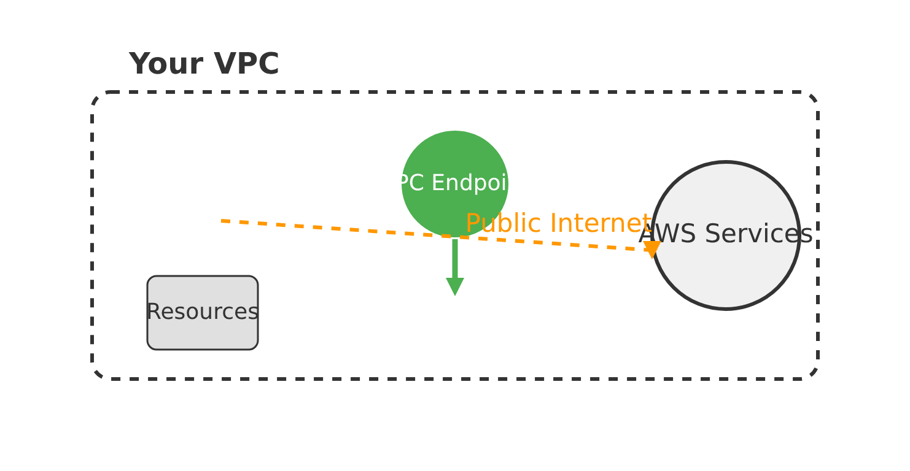





What is a VPC Endpoint?
Definition
VPC Endpoint Solution
A VPC Endpoint is a virtual network device that enables private connectivity between your VPC and supported AWS services.
The Problem It Solves
Before VPC Endpoints, instances in private subnets required:
NAT Gateway or Internet Gateway
Public internet traversal
Additional costs and complexity
VPC Endpoints eliminate the need for public internet traversal, keeping all communication within the secure AWS network.
Enhanced Security
Improved Performance
Cost Reduction

Slide 70









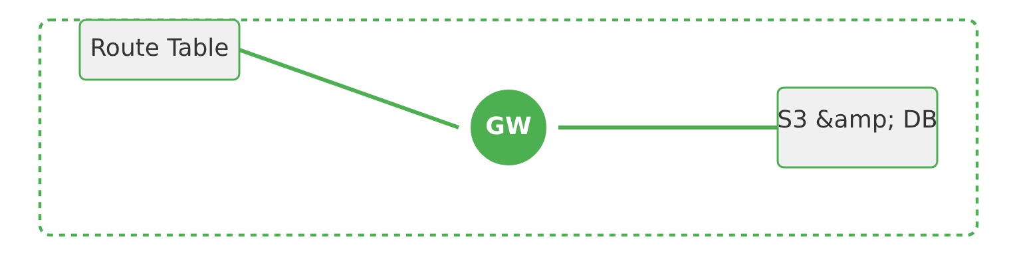
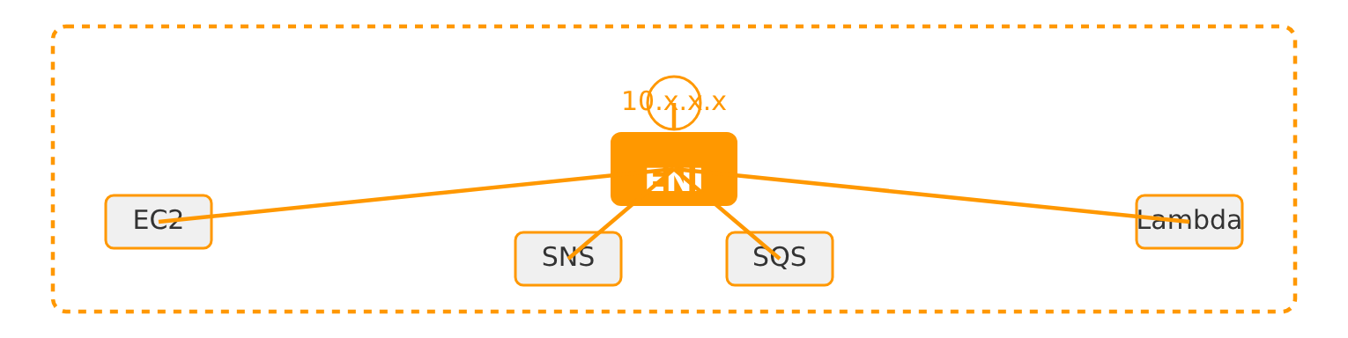
Types of VPC Endpoints
AWS provides two primary types of VPC Endpoints for private connectivity:
Gateway Endpoints
Interface Endpoints
Key Characteristics:
Key Characteristics:
For S3 and DynamoDB only
Wide array of AWS services
Uses route table entries
Uses ENI with private IP
Free of charge
Supports security groups

Slide 71



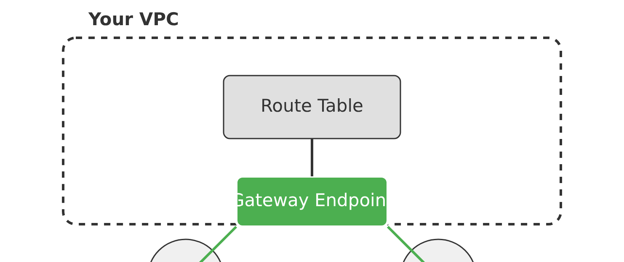







Gateway Endpoints
Gateway Endpoints enable private connectivity to Amazon S3 and DynamoDB, routing traffic through your VPC's route tables without traversing the public internet.
How Gateway Endpoints Work
Key Characteristics
Supported Services
Amazon S3 and DynamoDB only
Connectivity Method
Route table entries with prefix lists
Cost
Gateway Endpoint adds route table entries to direct traffic to S3/DynamoDB through the endpoint
Free of charge - no hourly or data processing fees
Important Considerations
No security group support
No private DNS support
Free of charge
Gateway Endpoints are the cost-effective solution for S3 and DynamoDB connectivity

Slide 72



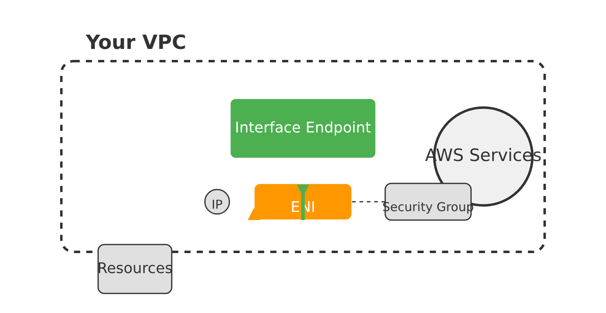
















Interface Endpoints
Interface Endpoints provide private connectivity to a broad range of AWS services, services hosted by other AWS customers (via AWS PrivateLink), and your own services.
How Interface Endpoints Work
Key Features
ENI-Based Connectivity
Creates an Elastic Network Interface (ENI) with a private IP address in your specified subnets
Broad Service Support
Supports over 100 AWS services including API Gateway, CloudWatch, KMS, and custom endpoint services
Enhanced Security
Supports security groups to control access to the endpoint ENIs
Private DNS Support
Supports private hosted zones and split-horizon DNS for seamless service discovery
Cost Considerations
Traffic Flow
Pay-as-you-go
Traffic flows through the ENI, remaining entirely within the AWS network
Hourly charges for each ENI plus data processing fees
AWS PrivateLink
Multiple Services
Security Groups
Private DNS

Slide 73




















Gateway vs. Interface Endpoints: Comparison
Feature
Gateway Endpoint
Interface Endpoint
Supported Services
Amazon S3 and DynamoDB only
Most AWS services and private VPC endpoint services
Connectivity Method
Route table entries with prefix lists
ENI-based with private IP per subnet
Private DNS Support
No
Yes
Security Group Support
No
Yes
Cross-VPC/On-Prem Support
No
Yes (via peering, Direct Connect)
Cost
Free
Hourly + data processing charges
Availability Zone Specific
No (VPC-wide)
Yes (one subnet per AZ)
Key Takeaway: Choose Gateway Endpoints for S3 and DynamoDB for cost-free connectivity. Use Interface Endpoints for broader service compatibility and advanced features.

Slide 74








Benefits of VPC Endpoints
Enhanced Security
Improved Performance
Traffic remains within AWS network
Reduced network latency
Reduced exposure to external threats
Faster application response
Cost Optimization
Simplified Architecture
Gateway Endpoints for S3/DynamoDB are free
Eliminates Internet Gateways/NAT devices
Avoids NAT Gateway costs
Simplifies network design

Slide 75




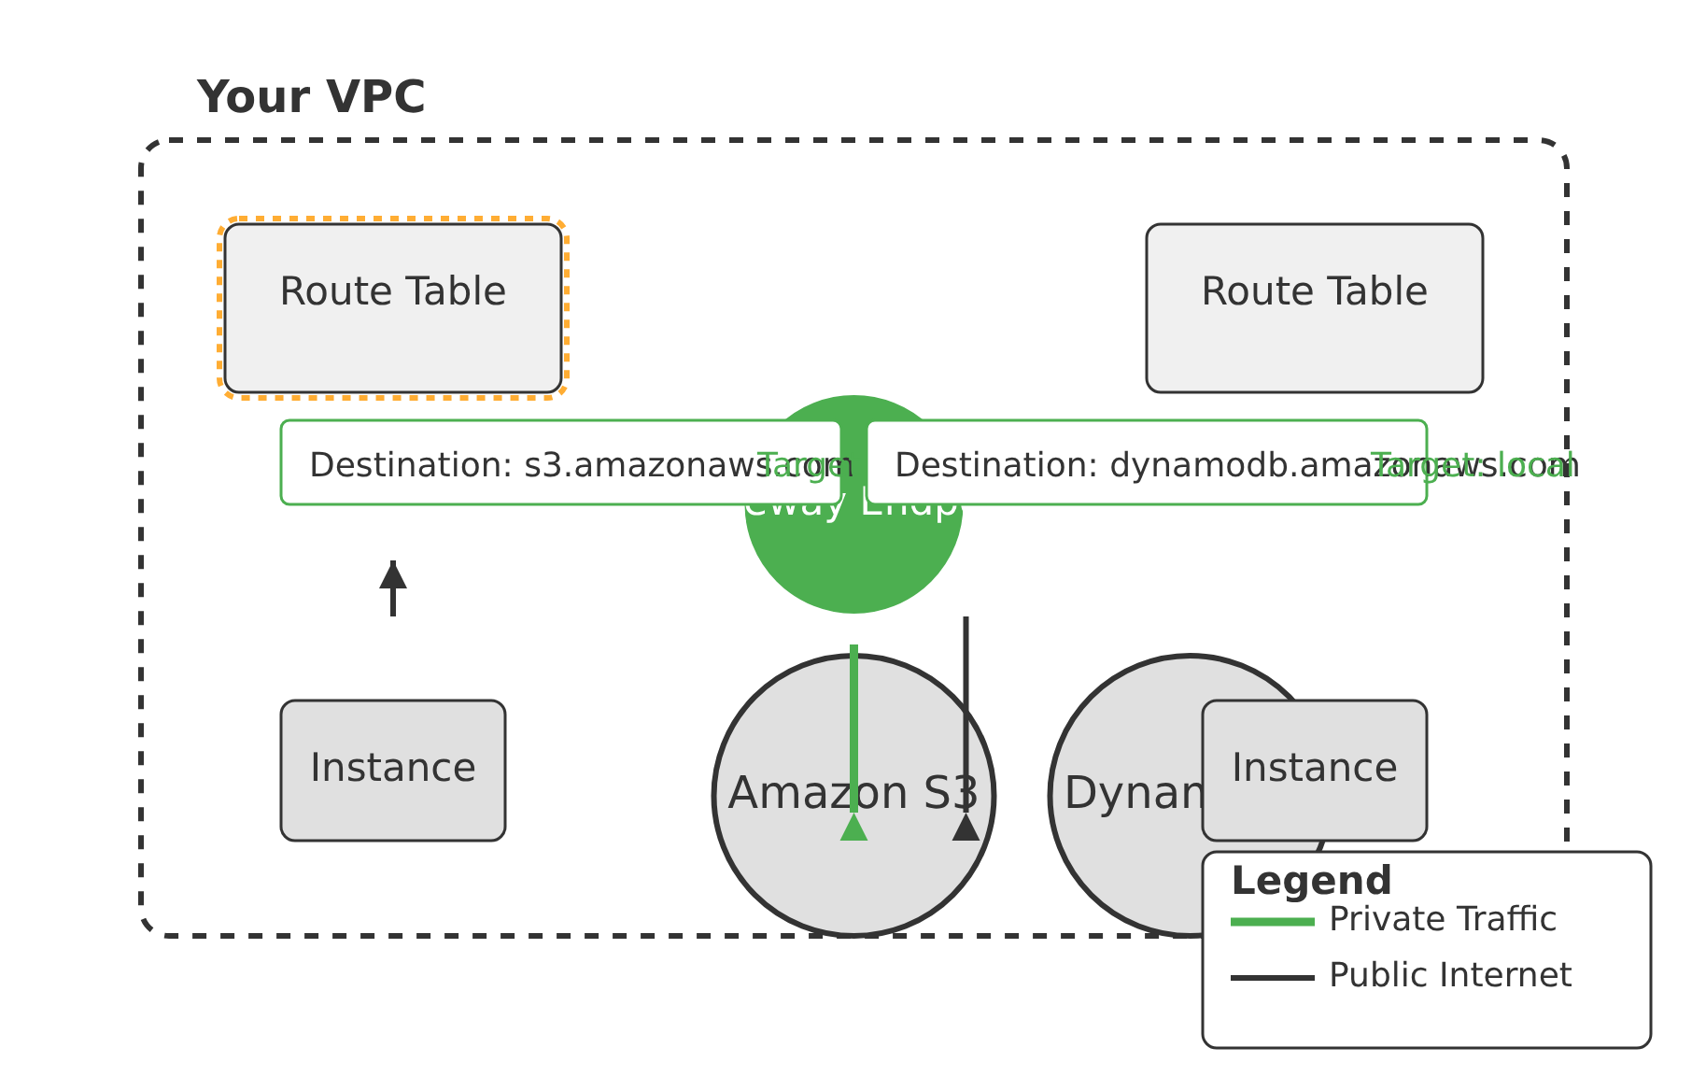


How Gateway Endpoints Work
Technical Implementation
Route Table Implementation
When a Gateway Endpoint is created for Amazon S3 or DynamoDB:
Specific route table entries are automatically added to your VPC's route tables
These entries direct traffic for the service's prefix list through the Gateway Endpoint
Instances in associated subnets can access S3/DynamoDB privately
No Internet Gateway or NAT device is required
Key Characteristics
Free of charge
Specifically for Amazon S3 and DynamoDB
Uses route table entries
Does not support security groups
Does not support private DNS

Slide 76




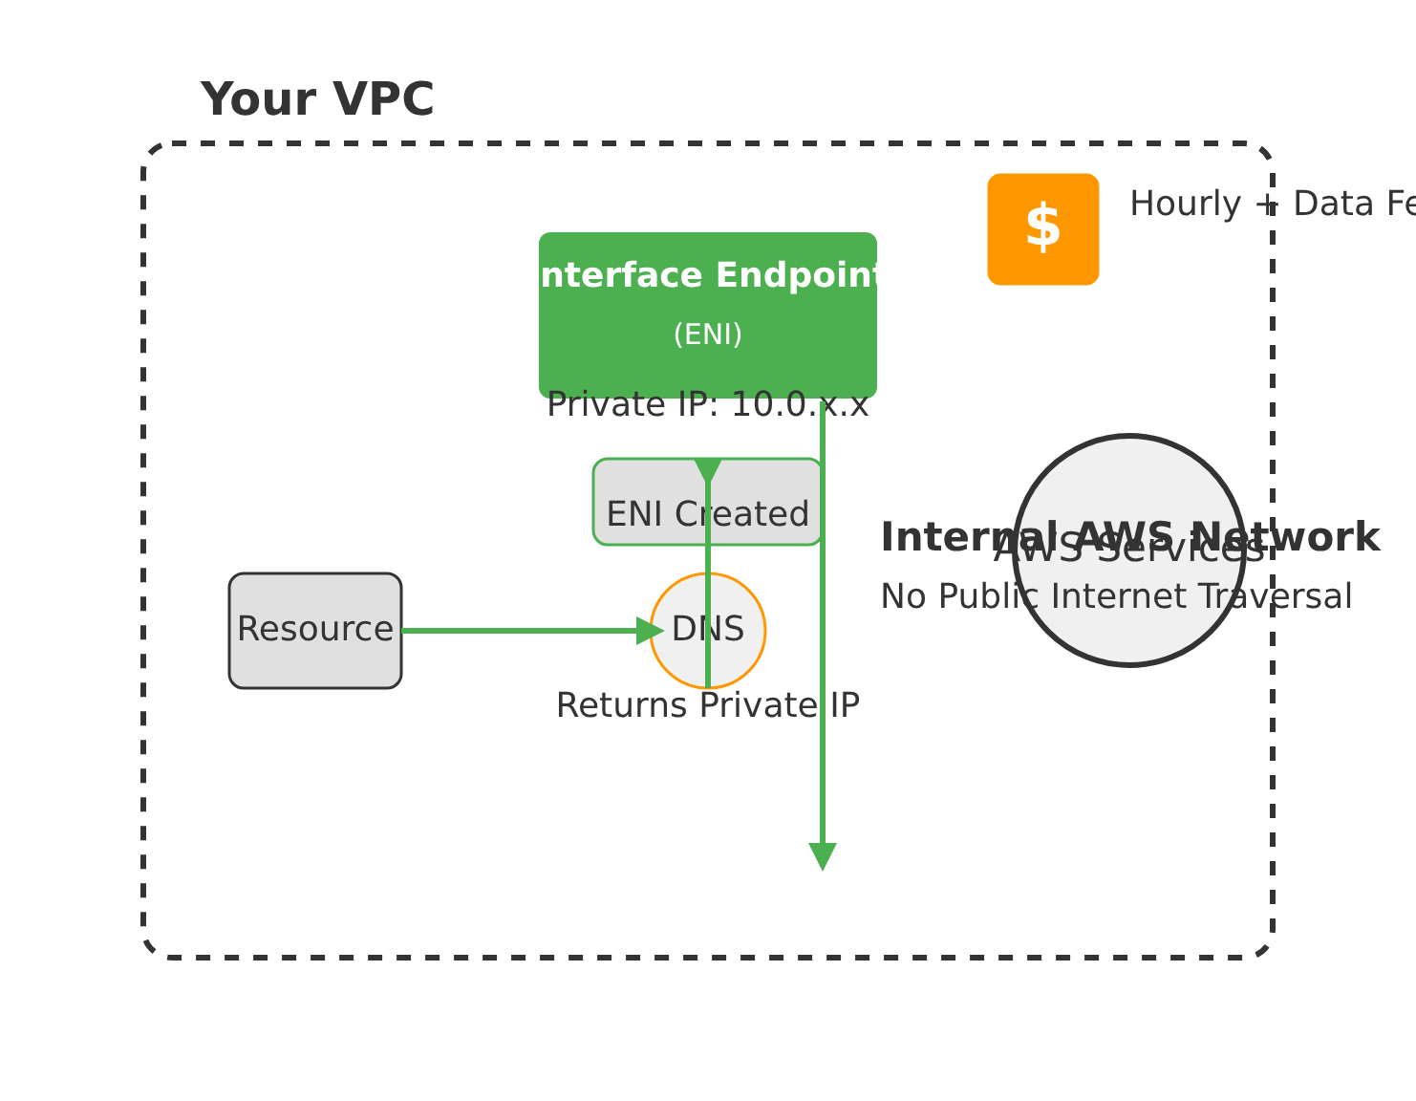



How Interface Endpoints Work
1. ENI Creation
Interface Endpoint Flow
Interface Endpoints create an Elastic Network Interface (ENI) with a private IP address in your specified subnets.
2. DNS Resolution
When an instance attempts to access a supported AWS service, DNS resolution returns a private IP address associated with the endpoint's ENI.
3. Traffic Routing
Traffic flows through the private ENI within the VPC, staying entirely within the AWS network and routed internally to the target service.
Key Components
ENI: Elastic Network Interface with private IP
DNS: Private IP address resolution
Cost Considerations
Routing: Internal AWS network routing
Interface Endpoints incur hourly charges and data processing fees, unlike Gateway Endpoints which are free.
Powered by AWS PrivateLink
Private IP Addressing
Fully Within AWS Network

Slide 77







Question 1
Which type of AWS VPC Endpoint is specifically designed for connecting to Amazon S3 and DynamoDB without incurring additional cost?
A
Interface Endpoint
B
Gateway Load Balancer Endpoint
Connects to multiple AWS services but has associated costs
For use with Network Load Balancers, not S3/DynamoDB
C
Gateway Endpoint
D
PrivateLink Endpoint
Specifically designed for S3 and DynamoDB, no additional chargess
For use with AWS PrivateLink, not directly for S3/DynamoDB

Slide 78






Correct Answer: C. Gateway Endpoint
Explanation:
Gateway Endpoints are specifically designed to provide private connectivity to Amazon S3 and DynamoDB without incurring additional charges.
Implemented as a target in your VPC's route table
Specifically designed for Amazon S3 and DynamoDB
No additional charges for their use
Gateway Endpoint
Interface Endpoint
Specifically for S3 and DynamoDB
Supports wider range of services
No additional charges
Typically has associated costs
Implemented as route table target
Uses Elastic Network Interface (ENI)

Slide 79

Question 2
What is the primary benefit of using AWS VPC Endpoints?
A
To enable direct internet access for instances in private subnets
B
To allow cross-region communication between VPCs without peering
Contradicts the purpose of VPC Endpoints
Not the primary benefit of VPC Endpoints
C
To provide private and secure access to AWS services without traversing the public internet
D
To simplify DNS resolution for public AWS service endpoints
Not the main advantage of VPC Endpoints
Enhances security and reduces latency

Slide 80










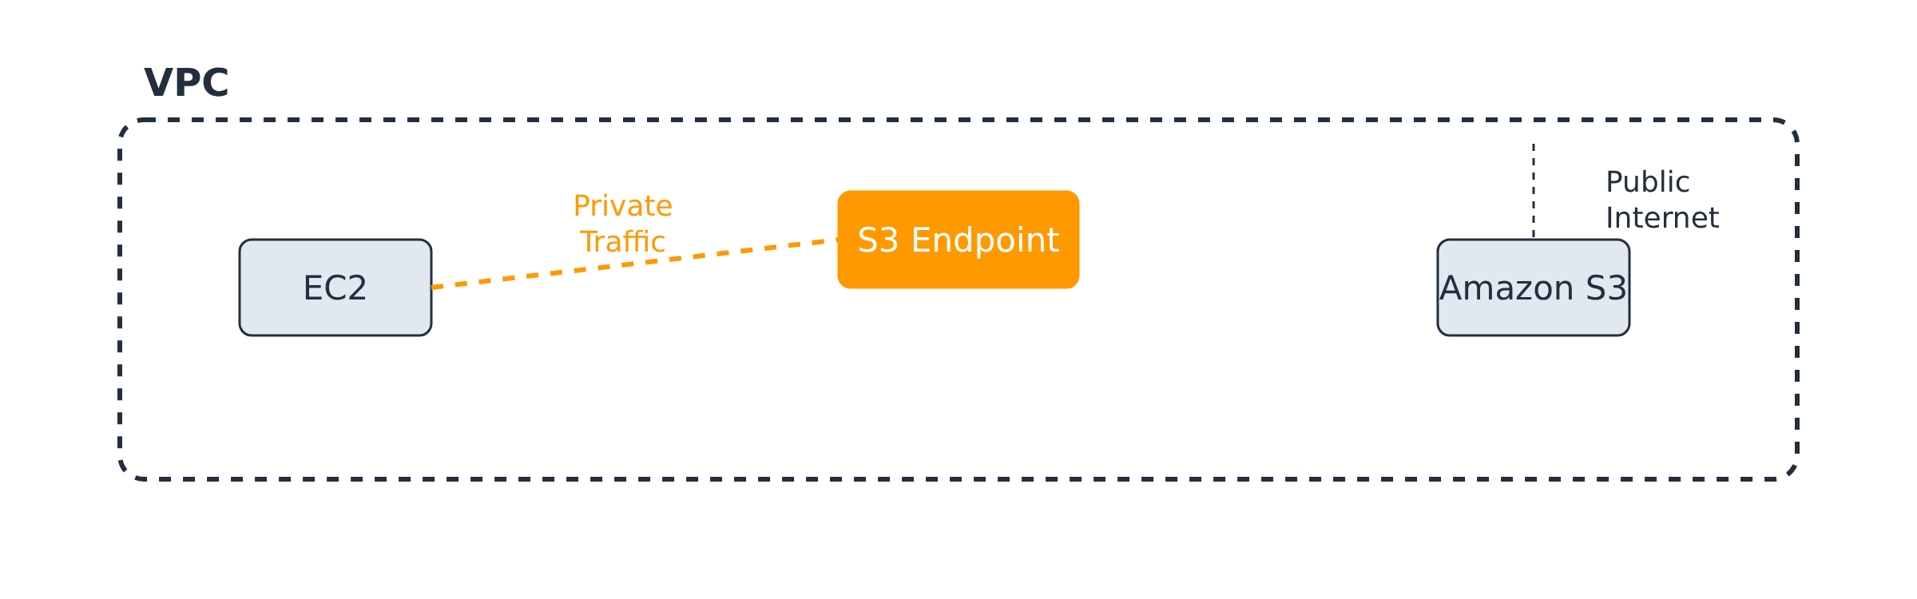
Correct Answer: To provide private and secure access to AWS services without traversing the public internet.
Explanation:
VPC Endpoints allow instances within a VPC to privately connect to supported AWS services. This means traffic stays within the AWS network, enhancing security, reducing latency, and often lowering data transfer costs.
Enhanced Security
Reduced Latency
Cost Efficiency
Traffic remains within the AWS network, reducing exposure to the public internet.
Private connectivity to AWS services results in lower network latency.
Bypasses the need for Internet Gateways, NAT devices, VPN, or Direct Connect.

Slide 81












Question 3
An Interface VPC Endpoint uses which of the following to provide private connectivity to AWS services?
A
An Internet Gateway
Connects to public internet
Interface Endpoint
B
A NAT Gateway
Enables private-to-public translation
C
An Elastic Network Interface (ENI) with a private IP address
AWS Service
Entry point for traffic within VPC
Private Connectivity
D
A public IP address assigned to the service
Uses public addressing

Slide 82







Correct Answer: C. An Elastic Network Interface (ENI) with a private IP address
Explanation:
Interface Endpoints are powered by AWS PrivateLink and create an Elastic Network Interface (ENI) with a private IP address in your specified subnets.
The ENI acts as the entry point for traffic destined for the AWS service, keeping the communication private within your VPC.
Interface Endpoints do not rely on Internet Gateways, NAT Gateways, or public IP addresses for the service connection.
They provide private connectivity to AWS services without traversing the public internet, enhancing security and reducing latency.
VPC
ENI
AWS Service
Private IP

